Slide 1
Count data
SSA 200

Slide 2
Count Data
How was it collected?
Opportunistic
(e.g. citizen science)
Survey
(e.g. transects, repeated counts, mark-recapture)
Repeated visits within a closed period?
N–Mixture Models
Poisson GLM
Yes
No
Notes:
Remind everyone that they have this flow chart in their handouts – it is not exhaustive!
Good practice to ask HOW the data was collected and get as much information about the sampling design because this dictates what type of analysis you can do and may limit your inference.

Slide 3
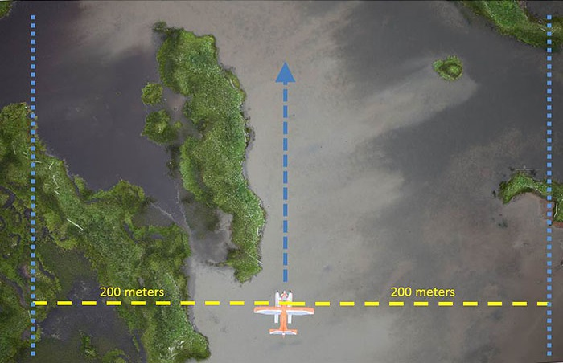
Count data
Typically collected annually or seasonally
Data collection methods
Camera surveys
Aerial surveys
Point counts
Transects
Notes:
In ecology, we have a number of methods to count individuals in a population
Count data is usually collected annually or seasonally
It may be collected using things like camera surveys, aerial surveys, point counts, or transects among other methods.
I work with waterfowl and most surveys are conducted using aerial transect surveys
The pilot and 1-2 other observers identify the species and number of individuals within 200 meters of their side of the plane
They’re flying ~ 100 mph and ~100 feet off the ground
As you might imagine detecting individuals of multiple species while flying can be very difficult
Which is why I want to start with some of the problems you may face with count data

Slide 4

Problems with count data
Sampling and observation errors
Target population not fully sampled
Individuals present but not detected
Double counting
Misidentified individuals
Notes:
Count data is subject to a number of different problems
Most of which can be attributed to sampling and observation errors
For instance, you may not adequately sample the target population (spatial + logistic problems)
Individuals may be present but are not detected (imperfect detection)
You may double count individuals → in aerial surveys you may push individuals in front of you and accidentally count them 2 or more times
You may also misidentify individuals by age, sex, or species
To your right this photo really exemplifies imperfect detection at its best. In this photo there is a copperhead snake…can anyone see it?

Slide 5

Problems with count data
Sampling and observation errors
Target population not fully sampled
Individuals present but not detected
Double counting
Misidentified individuals
Notes:
Even with the snake highlighted on this photo it is difficult for me to make out and this person was basically standing right over it. The point is, animals and plants can be hard to see and we need to consider this!
Key References
Kery, M. and Schmidt, B. 2009. Imperfect detection and its consequences for monitoring for conservation. Community Ecology.
Gerber, B. and Kendall, W. 2016. Evaluating and improving count-based population inference: A case study from 31 years of monitoring Sandhill Cranes
* The introduction of this paper provides a great review of count data and relevant assumptions!

Slide 6
Correcting count data
We can correct count data for detection if data was specifically collected to estimate detection
Study design was set to capture information on detection and counts
A separate study was designed to estimate detection probability
Detection data can be collected by
Distance sampling
Double observer study
Repeated counts at several sites within a closed period
Etc.
Notes:
In an ideal world, we could correct count data for detection problems, although this is easier said than done
Sometimes, count data can be collected in manner that makes it possible to estimate detection probability. This does not occur often especially for unlisted or non-game species because it is costly, time-consuming, and likely logistically infeasible.
In some cases, studies may be employed specifically to estimate detection probability to post-hoc correct counts and estimate abundance. This is often difficult to do and is the exception rather than the rule.
Detection data can be collected by the following methods, although this is not an exhaustive list these are fairly common options.
When you’re given your count data make sure to get information on the sampling design to determine if you can adjust the counts for detection or not
This is a fundamental step and determines what type of inference you can make from the data!

Slide 7

What if we can’t correct for detection?
All is not lost, but understanding the data limitations is critical
What can we estimate?
Relative abundance or an abundance index
Trend in relative abundance
Relationships with ecological covariates
Assumptions
Detection is constant over time
How can we do it?
Generalized linear models (GLM)
State-space models (SSM)
Notes:
For most of you, controlling or altering the sampling design is not an option
You are usually just handed a file with counts
Therefore, you have to make some strong assumptions about the underlying sampling and observation errors to move forward
First, it is important to note that without estimating detection and correcting the counts you are only estimating apparent abundance or an index of abundance
You have to make the assumption that detection is perfect or is at the very least constant over time
You can move forward and analyze the non-repeated count data with a GLM or SSM
I won’t be taking a deep dive into either of these methods but I do want you to be familiar with the concepts. I have included important citations for all of the methods throughout the presentation in the notes sections.

Slide 8
Generalized linear models
GLMs are based on an assumed relationship called a link function between a linear predictor of the explanatory variables (ecological covariates) and the response variable (count)
GLMs are an extension of the linear model
Used when error is non-normally distributed
Most ecological data is non-normal!
Notes:
GLM’s are based on an assumed relationship called a link function between a linear predictor of the explanatory variables and the response variable
Random component: Response variable (expected counts)
Systematic component: specifies the explanatory variables (x_{1,} x_{2..}) as the linear predictor
β₀ + β₁x₁ + β₂x₂
Ecological covariates
Link function: specifies link between random and systematic components
Describes how the expected value of the counts relates to the linear predictor of explanatory variables

Slide 9
Generalized linear models
Counts typically modeled using a Poisson distribution
If data is over dispersed or there are a lot of 0’s
Negative Binomial
Zero-inflated Poisson
Count data must reasonably follow the chosen distribution
Model selection
May test a number of ecological covariates
Use AIC to compare candidate models within a dataset, but not among datasets
Notes:
When you count animals or plants you are counting whole individuals that may range from 0 to infinity. The Poisson distribution is commonly used when modeling counts. However, your count data may be overdispered, meaning you could have many low counts and a few very high counts which cannot be fitted using a Poisson. Alternatively, with rare or difficult to detect species, you may have a lot of 0’s in your count data. In these cases you can use a Negative Binomial which includes a dispersion parameter or a Zero-inflated Poisson which is good for zero inflated data.
The major assumption here is that your count data must reasonably follow the chosen distribution. This is something you can test within R or ask the modeler to determine the best distribution to use.
You can model counts using a number of ecological covariates and similar to occupancy models you can determine which of your models (or biological hypotheses) best fits the data relative to your other models.

Slide 10
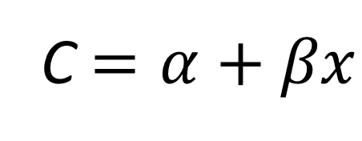
Generalized linear models
Poisson Generalized Linear Model
Discrete, non-negative integers (0, 1, 2, ..)
One parameter guides mean and variance
Poisson distribution
C $=α+βx$
Frequency
Environmental/habitat covariates
Count
Notes:
Poisson distributions generate only discrete positive integers (aka 0, 1, 2, 3, 4…+inf). There is only one parameter and thus the mean and variance are equal.
Here, we are modeling the count (C) with a Poisson distribution as a function of an environmental or habitat covariate x. There are some additional complicating factors in a GLM not detailed here.
See these references for more details, or ask any of us if you have more questions!

Slide 11
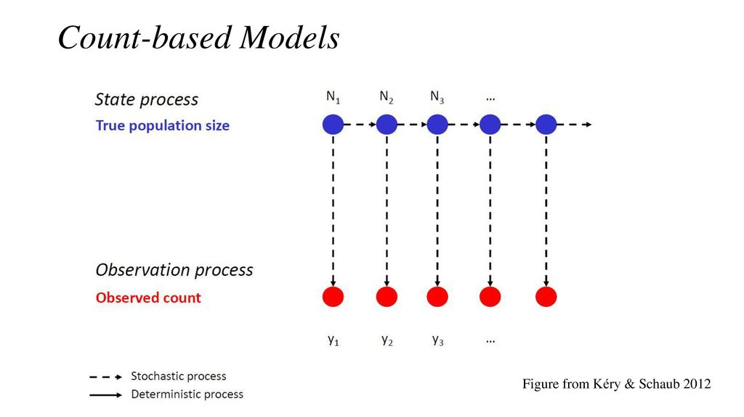
State-space models
Time series models
Model the true state of the system (abundance) as an unobserved process
Observed data (counts) are modeled conditional on the true state (abundance) and the observation error
Partitions variance in counts
Process error – Biological or process variation (e.g. demographic stochasticity)
Observation error – sampling variation
Notes:
Buckland, et al. 2004. State-space models for the dynamics of wild animal populations. Ecological Modeling.
Kery and Schaub 2012 Bayesian Analysis using WinBUGS (Chapter 5)
Hostetler and Chandler 2015 Improved state-space models for inference about spatial and temporal variation in abundance from count data. Ecology.
Newman et al. 2014. Modelling Population Dynamics: Model Formulation, Fitting and Assessment using State-Space Methods (all chapters)

Slide 12
State-space models
Provides estimates of population growth rate
Accounts for sampling variation (observation error) and process error (variation in abundance)
Drawbacks
Cannot correct for bias in counts relative to true abundance
Can be relatively complex
Simple models suffer from estimation problems
Model fit and selection are difficult
Notes:
You can use count data to estimate population growth rate (still assuming constant or perfect detection)
Account for sampling variation and process variation – but cannot get rid of it!
Some drawbacks include:
Model can deal with teasing apart sampling variation but it cannot correct for bias in counts
Models can be relatively complex and/or difficult to code
Simple models may suffer from estimation problems
Model fit and selection are difficult and are often ignored

Slide 13
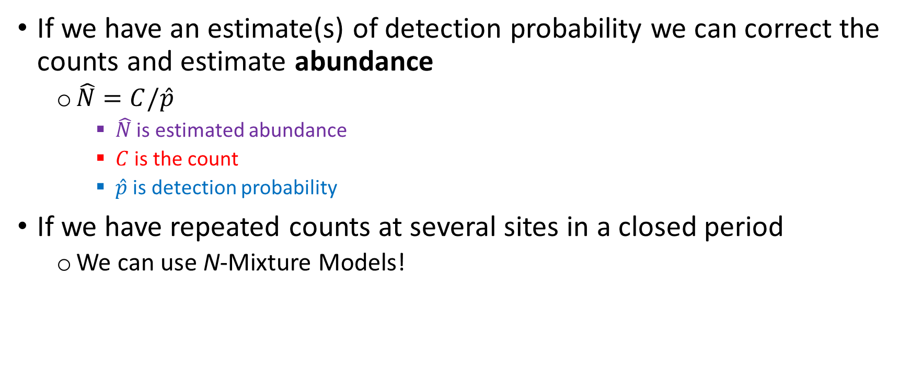
What if we can correct for detection?
If we have an estimate(s) of detection probability we can correct the counts and estimate abundance
$\hat{N}=C/\hat{p}$
$\hat{N}$ is estimated abundance
$C$ is the count
$\hat{p}$ is detection probability
If we have repeated counts at several sites in a closed period
We can use N-Mixture Models!
Notes:
If there are estimates of detection probability from separate studies (taken from literature) you can use the canonical population estimator to estimate abundance (N) by dividing the count (C) by the detection probability (p).
This is the most basic method for correcting counts (see Williams et al. 2002 Analysis and management of animal populations)
IF you have data on detection probability you can correct the counts and then use any of the aforementioned models with the abundance estimates to model ecological covariates, estimate population growth, and in SSM partition variance in biological processes and sampling processes

Slide 14
N-mixture models
Use repeated counts at several sites to estimate detection probability directly
Can include covariates associated with either abundance or detection
Explicitly model spatial and temporal variation
Called “mixture” because it combines two GLMs
Poisson GLM – abundance
Binomial GLM (Logistic regression) – detection
Notes:
N-mixture models require that there were repeated counts at several sites during a closed period.
* This allows for the estimation of detection to correct the counts and use to estimate abundance.
N mixture models are very similar to occupancy models, technically, occupancy means that N>0 and therefore, occupancy can be estimated using the same abundance data used in N-mixture models.
In these models we can include covariates on abundance and detection to explicitly model spatial and temporal variation.
They are called mixture models because it combines two generalized linear models. The typical model framework includes a Poisson GLM to model abundance and a Binomial GLM to model detection. The Binomial simply states that we only count some proportion of individuals in the true population.
Key References
Books
Kery, M. and Royle, A. 2016. Applied hierarchical modeling in ecology.
Kery, M. and Schaub, M. 2012. Bayesian population analysis using WinBUGS → The authors explain everything I have discussed here from the most basic details up, along with code. I highly recommend this book!
Papers
Royle, A. 2004a. Generalized estimators of avian abundance from count survey data. Animal Biodiversity Conservation.
Royle. A. 2004b. N-mixture models for estimating population size from spatially replicated counts. Biometrics

Slide 15
N-mixture models
Model detection as a function of covariates
Survey timing, observer
Habitat or weather
Model abundance as a function of covariates
Habitat type
Presence/absence of predators
Include these covariates as predictors of species abundance
Notes:
It’s important to recognize that we can model both detection and abundance as a function of relevant covariates. For instance, we might expect that detection probability is different between observers, or it is affected by habitat type. Likewise, abundance may differ among habitat types or in the presence or absence of predators. We can use these covariates as predictors of species abundance across space.

Slide 16
N-mixture models
Assumptions
Sites closed to immigration/emigration between surveys
Detection process is independent at each site but can vary among sites
No double counting
Equal detection probability for all individuals within a sample
Model selection
Typically use AIC for both detection and abundance models
Assess relative fit of model sets to the data
Notes:
Like most models, there are a series of assumptions that must be met in order to produce unbiased estimates. In this case, nearly all of the assumptions need to be met during the sampling period and built into the sampling design. When you get data on a species you need to determine if these assumptions were met. If not, you may need to use a different model or different data set.
If data were collected appropriately, you may develop a number of biological hypotheses. At which point you can use AIC to assess the relative fit of the model sets and biological hypotheses.

Slide 17
Review
What types of questions should you ask before you choose an analysis for your count data?
What types of models are available for count data that are not corrected for detection?
Can you estimate abundance or only relative abundance with repeated counts at several sites within a closed period?
Notes:
You should be careful to ask questions about the sampling design! You need to know if the data was collected in a way that makes it possible to estimate abundance (either separately or in the same sampling period). Is there any information on detection probability?
Generalized linear models and State-space models
You can estimate abundance using an N-mixture model because this data is collected in a manner in which we can estimate detection probability!

Slide 18
What kind of data do you have?
Descriptive or categorical
Presence-type data
Counts
Demographic data
Follow the color of your data type!
How was it collected?
Opportunistic
(e.g. citizen science, historical records, museum specimens)
Survey
(e.g. transects, repeated counts, mark-recapture)
State transition model
State transition model
Repeated visits within a closed period?
Logistic regression
No
Species distribution model OR paired points analysis
Yes
Multinomial regression
Occupancy model
Poisson regression (counts)
Abundance estimation
Poisson regression (fecundity)
N-mixture model
Survival analysis (mark-recapture)
This roadmap is to serve as a general guide and is not an exhaustive list of all analysis options. Also, always check the specific assumptions of your planned modeling approach!

Slide 19
Questions?

